Slide 1
Tools
Shafiul hasan

Slide 2
Tools
Eclipse
Android Studio
JetBrains
Note pad

Slide 3
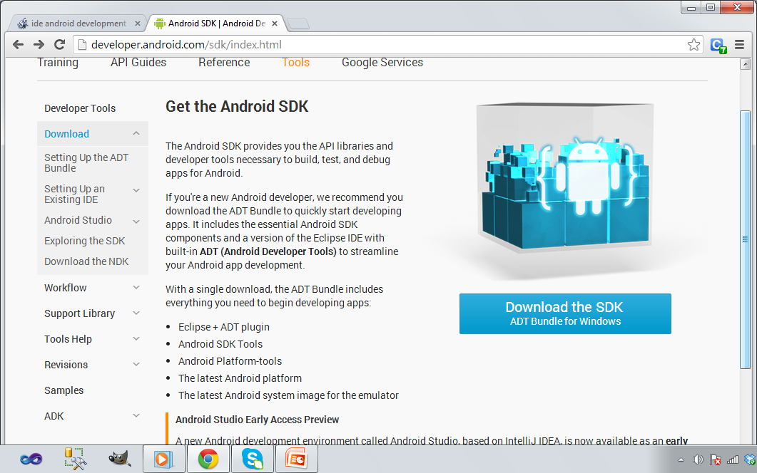
How to use Eclipse.
Very simple .
Go to the followig url
http://developer.android.com/sdk/index.html
and down load the
Just click this button

Slide 4
ECLIPSE ALREADY INSTALLED ?
If you have pre installed eclipse then add the ADT plugins in eclipse. Here is the steps.

Slide 5
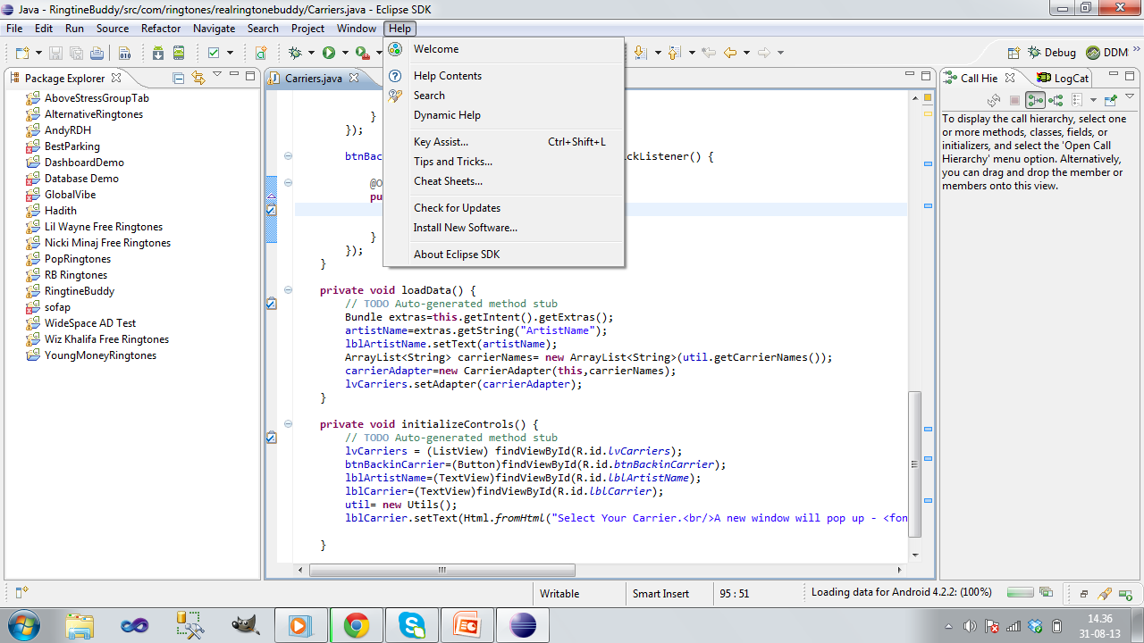
Go to help -> install new software.

Slide 6
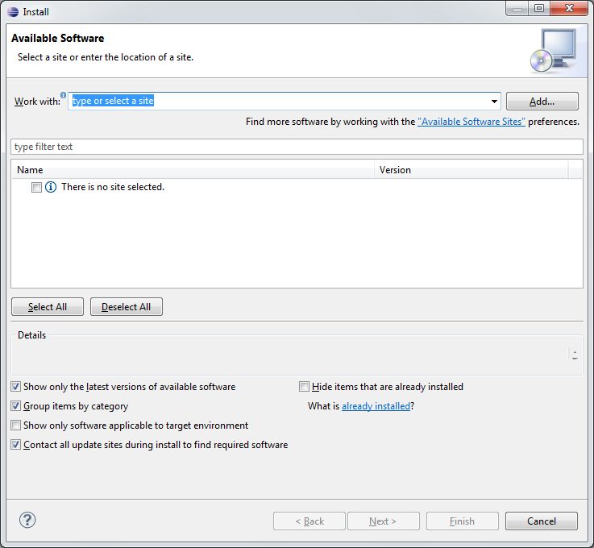
Click Add
Click Add

Slide 7
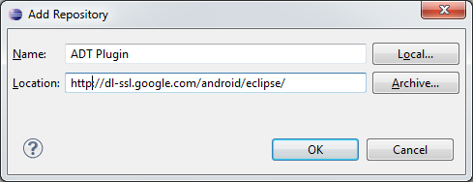
Use https:// or http://
Hit ok

Slide 8
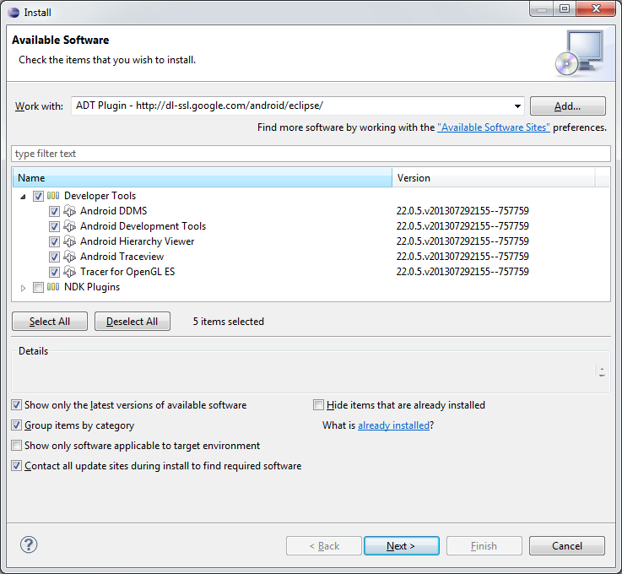

Slide 9
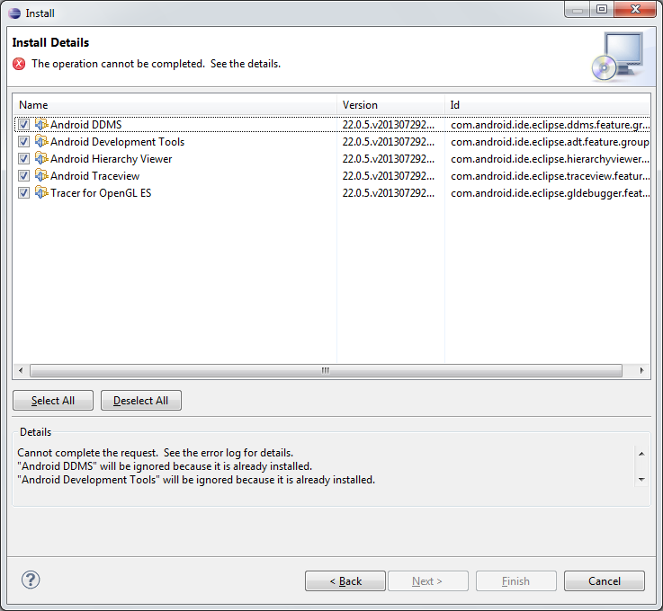

Slide 10
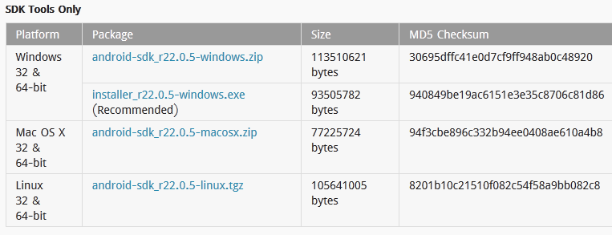
Read and accept the license agreements, then click Finish.
Download SDK from this link .
http://developer.android.com/sdk/index.html#ExistingIDE
Download your one ☺

Slide 11
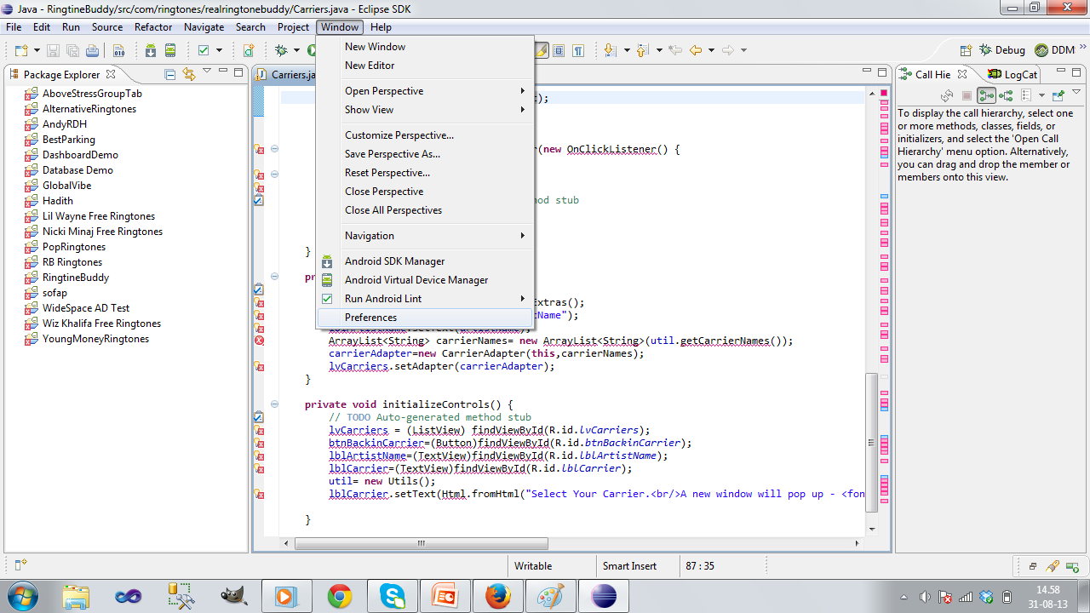

Slide 12
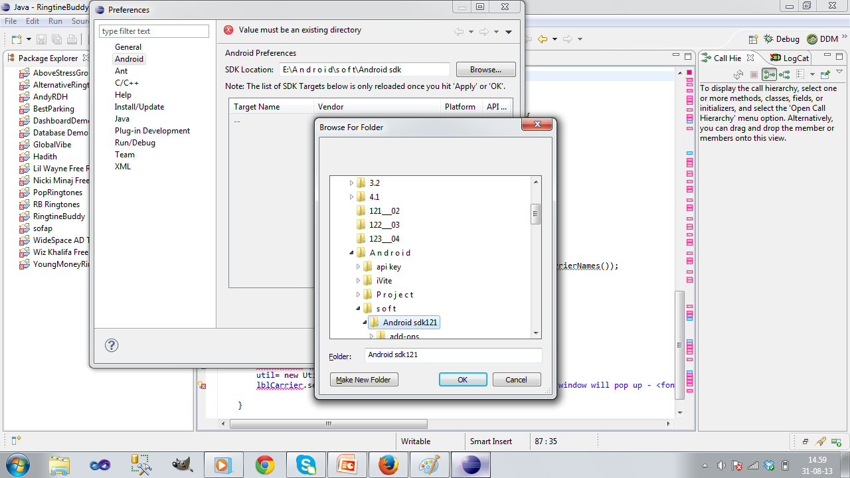

Slide 13
